Slide 1
Geography
Social Studies Lesson 1 – What is a State?

Slide 2
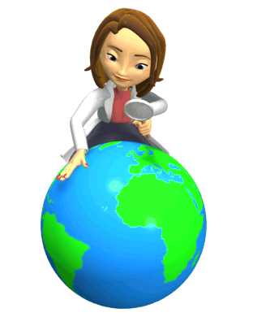
Geography
Geography is the study of
PLACES!
Geographers are people who study places.

Slide 3
Geographers Like to Ask Questions
Where is this place located?
What is this place like?
Does it belong to a larger region or place?

Slide 4
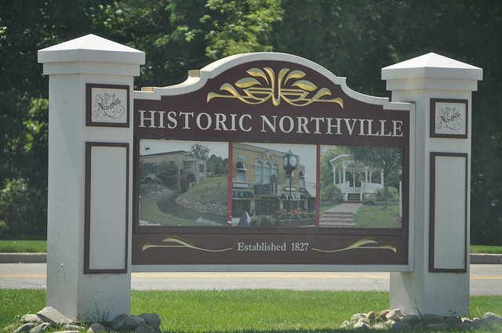
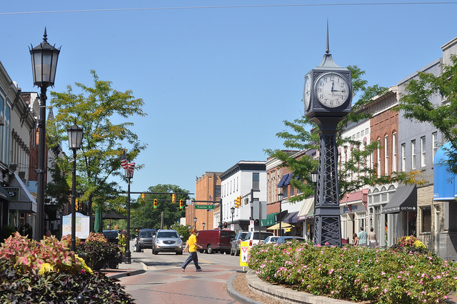
Our Community
A community is a place where we work, play, and live.
We live in the Northville
community.

Slide 5
What is Northville like?

Slide 6
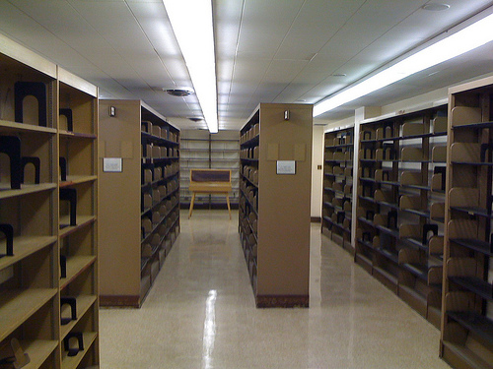
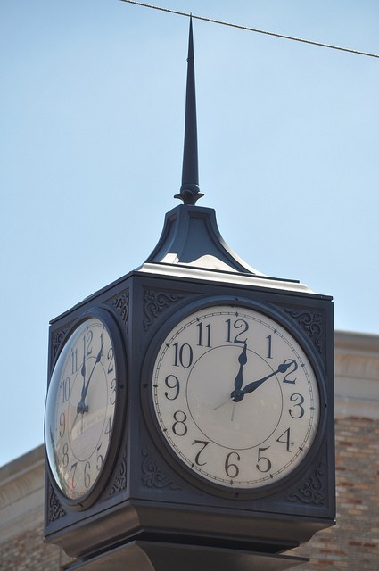
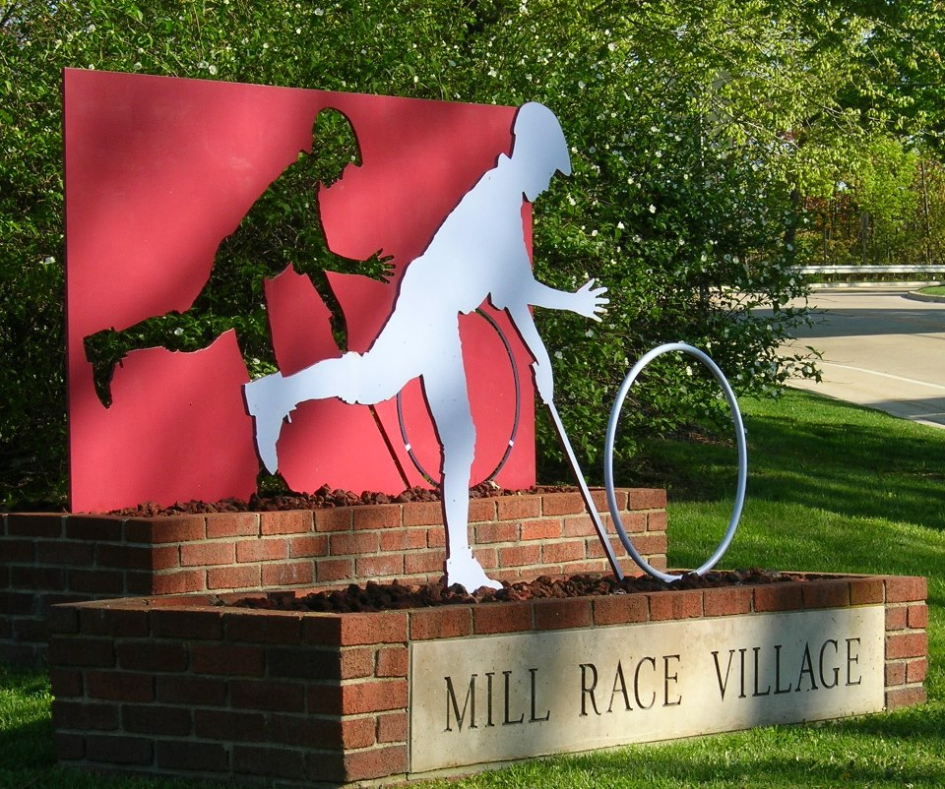
What are some of Northville’s important human characteristics?
Northville District Library
Northville Town Square – Clock tower

Slide 7
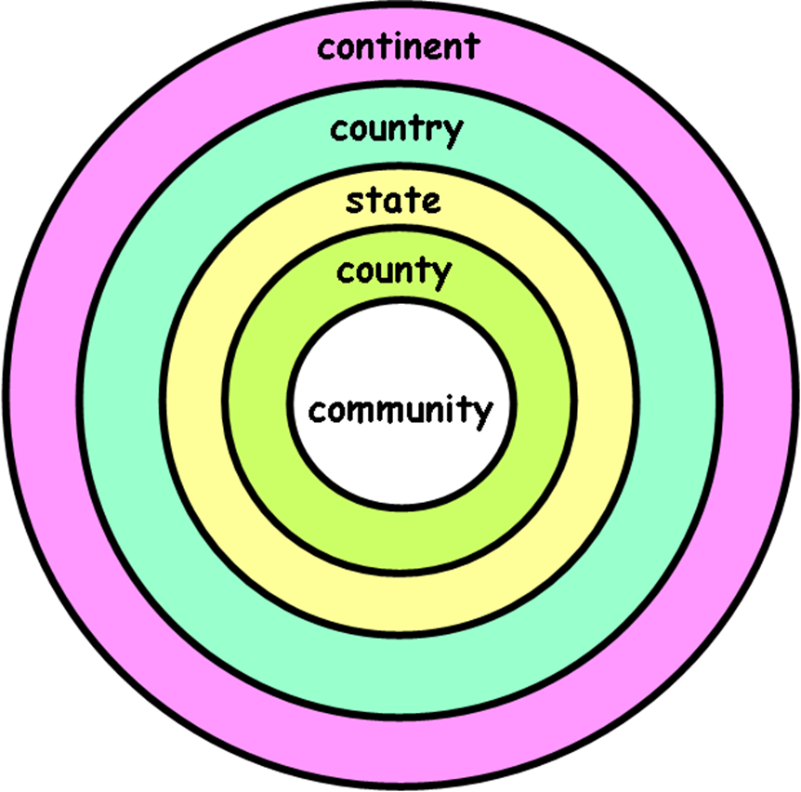
Where is it located and is it a part of a larger region?
County: Wayne County
State: Michigan
Country: United States
Continent: North America

Slide 8
A Closer Look
https://www.google.com/maps/@42.4325474,-83.4924865,4530m/data=!3m1!1e3

Slide 9
What is a STATE?
A state is one of the 50 parts of our country.
States are separated by borders.
What state do we live in?
How many states can you name?
(Group synergy activity)
What other states have you visited?

Slide 10
Exit Slip
Write at least 2 questions you have about Michigan.
Example: What are Michigan’s state symbols?

