Slide 1
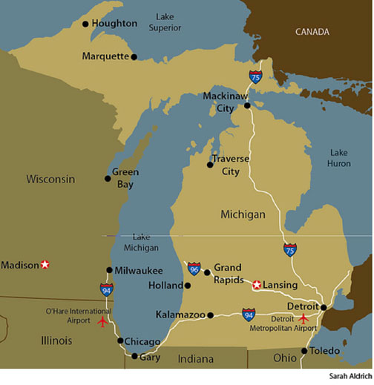
The Growth of Michigan
I can analyze how Michigan’s location and natural resources influenced its economic development.

Slide 2
How has Michigan changed over time?
Recap:
Once Michigan became a state, the fur trade ended.
Michigan became a popular place for farming because of its wealth of cheap land.
People began moving to Michigan to farm things like wheat, corn, and oats.
People also began building towns near farms to supply tools and needs.

Slide 3
What About Trees?
The early settlers felt mixed about trees – they were a valuable resource but also a problem.
What problems would trees cause for farming?
In 1830’s, this began to change. People began to see them as a valuable resource and an important economic activity.

Slide 4
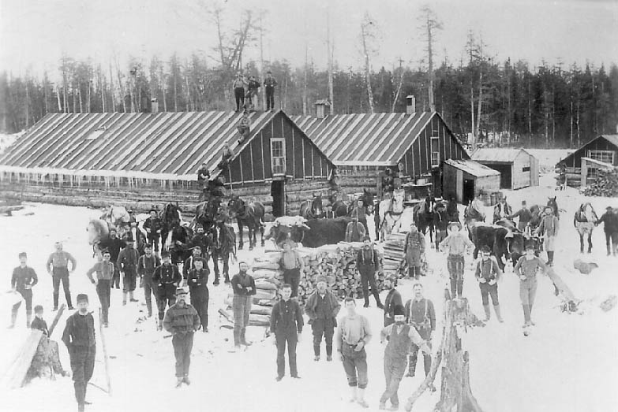
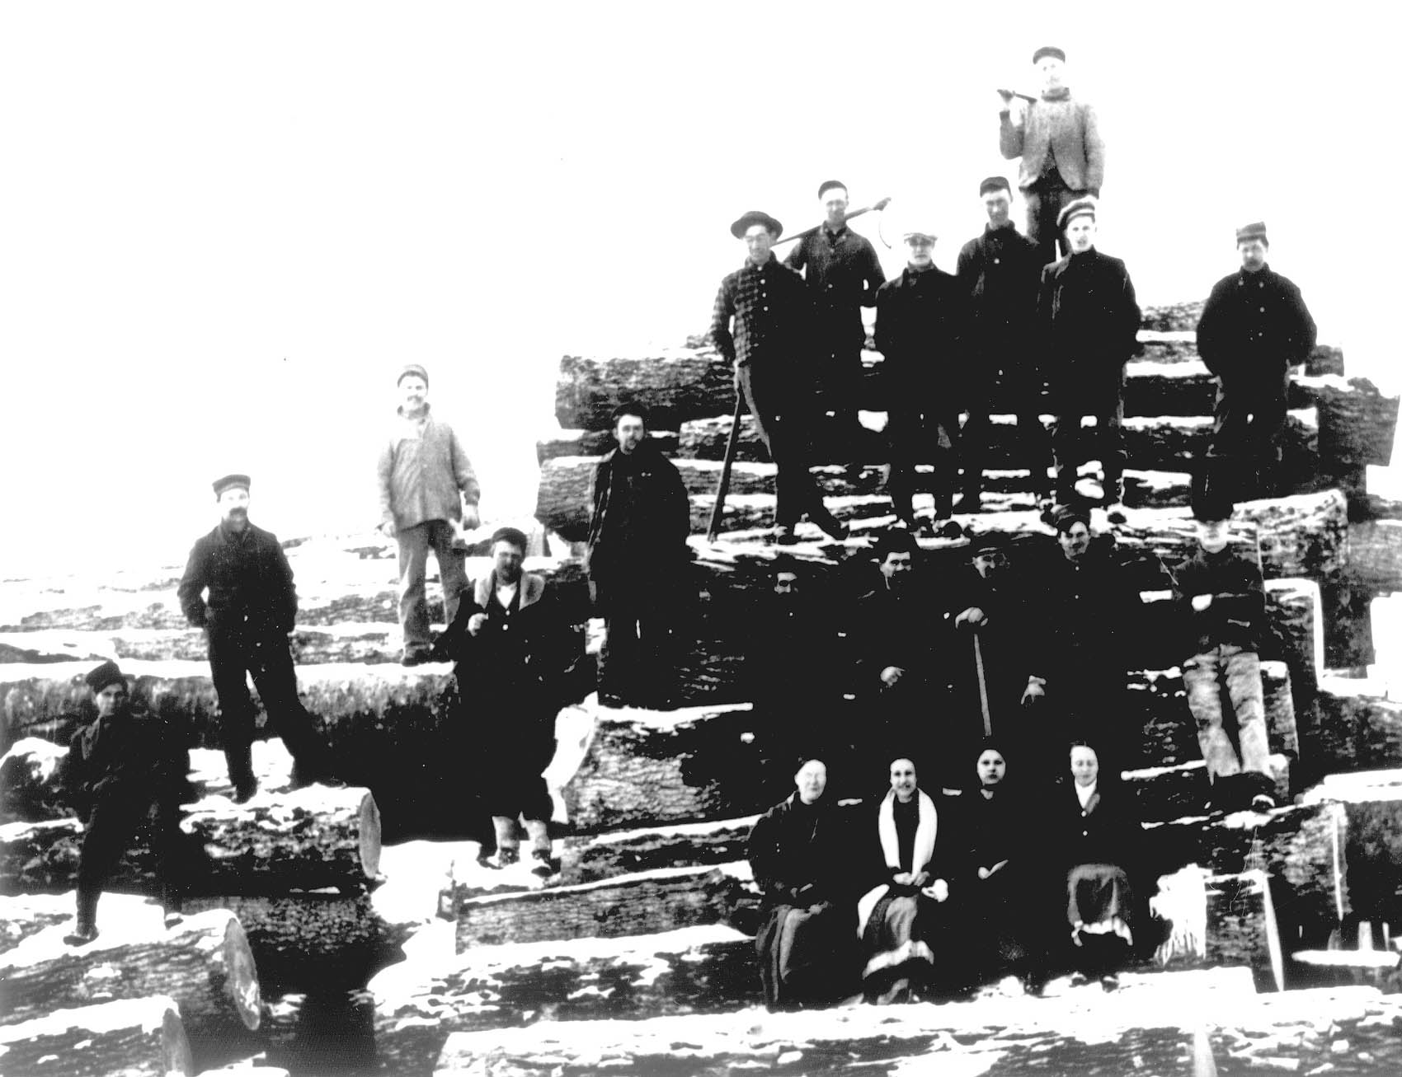
Another Important Economic Activity for Michigan

Slide 5
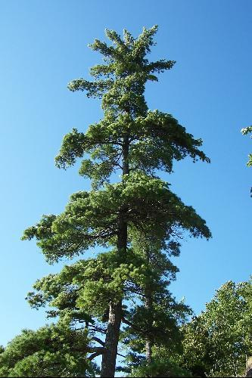
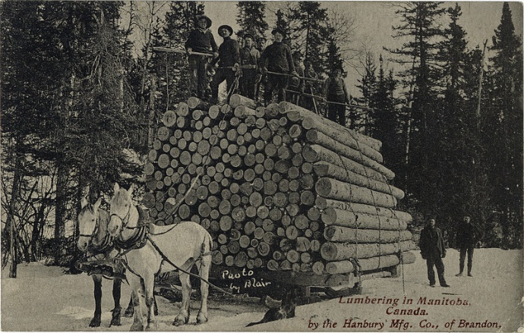
Growth of the Lumber Industry
Michigan had many white pine trees in the northern forests.
White pine was the most popular wood used for building in the 1800s. People began looking for places where they could find it and Michigan was just the place!

Slide 6
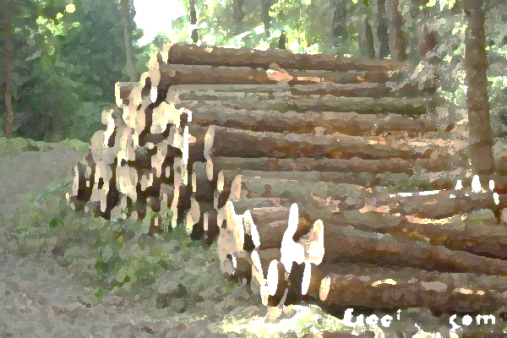
Why Michigan?
Think about Michigan’s natural characteristics. Why would Michigan be the ideal place for the lumber industry?
Michigan had a network of rivers that could be used to float the pines to sawmills located at ports on the Great Lakes.
When the fur trade ended and beavers were scarce, people in MI needed a new economic activity to take its place.

Slide 7
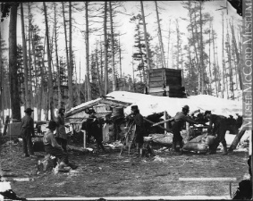
New Jobs in Michigan
The lumber industry created many jobs in Michigan.
See if you can identify different jobs that people had in the lumber industry.

Slide 8
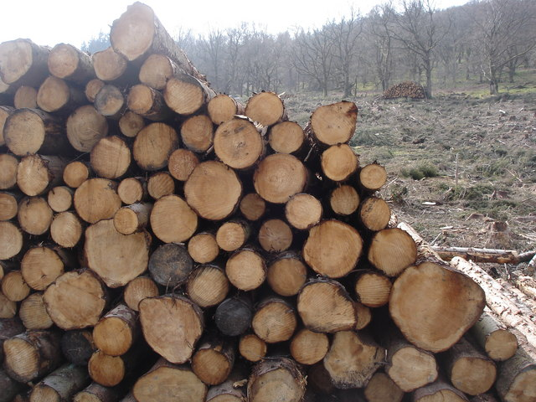
The Logging Process
A site was chosen for logging.
A logging camp was built on the site with a bunkhouse, stable, blacksmith shop, and cookhouse.
Workers moved into the camp.
Lumberjacks began to cut trees in winter.
Branches were taken off the trees and then the trees were cut into shorter logs about 15 feet long.
Sleighs were used to move the logs to the banks of a river.
Stampers put a log mark on the end of each log. This mark showed which company owned the log.
In spring the logs were pushed into the melting river.
Men called “riverhogs” rode the logs to the mouth of the river.
At the mouth of the river, “boomers” sorted the logs out by company.
The logs were floated to a sawmill where they are cut into boards.
The boards were stacked and dried.
Ships took the boards to cities like Chicago and Detroit.

Slide 9
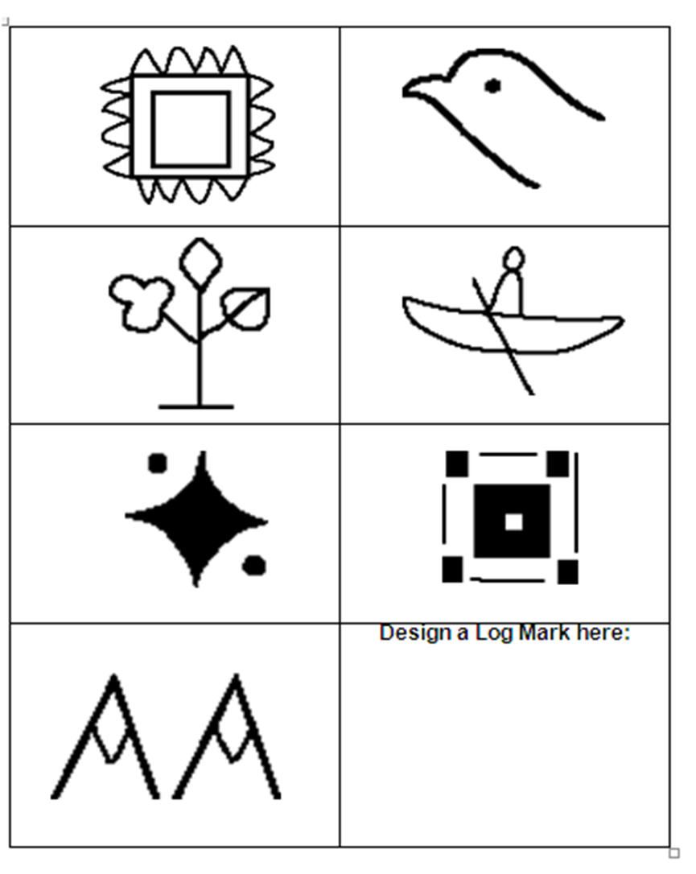
Log Marks
Lumbering companies used log marks to show which logs they owned since companies often used the same rivers to float their logs.

Slide 10
Michigan Logging Wheels
Known as “Big Wheels” these were used to carry logs to riverbanks and sawmills.
Companies could now log over all four seasons because big wheels could haul logs over land and ice covered roads.
https://www.youtube.com/watch?v=vuPZcsQ5vlc

Slide 11
Logging Railroad
The development of the logging railroad, which used small engines and portable track, also meant they could lumber year round.

Slide 12
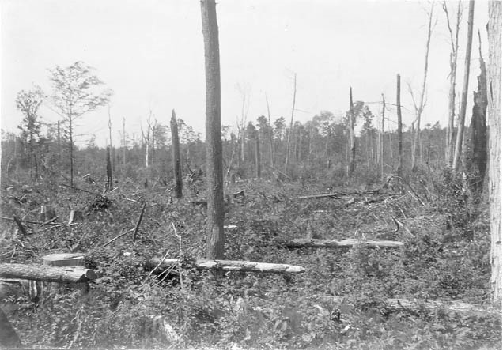
Improvements in Logging Industry
With all of these improvements for the logging industry, what did that mean for the trees?
Cutover lands
Stumps and brush

Slide 13
Where is the Green Gold?
http://www.michigan-history.org/greengold/GreenGoldFlash1.html

Slide 14
Green Gold Discussion Questions
What was green gold?
Why did the family want to go to the logging camp?
Why didn’t they want Tom to go?
What did the family do at the logging camp?

